Slide 1



movies data
View in Power BI
Last data refresh:
9/29/2025 5:38:51 AM UTC
Downloaded at:
9/29/2025 7:16:53 AM UTC

Slide 2
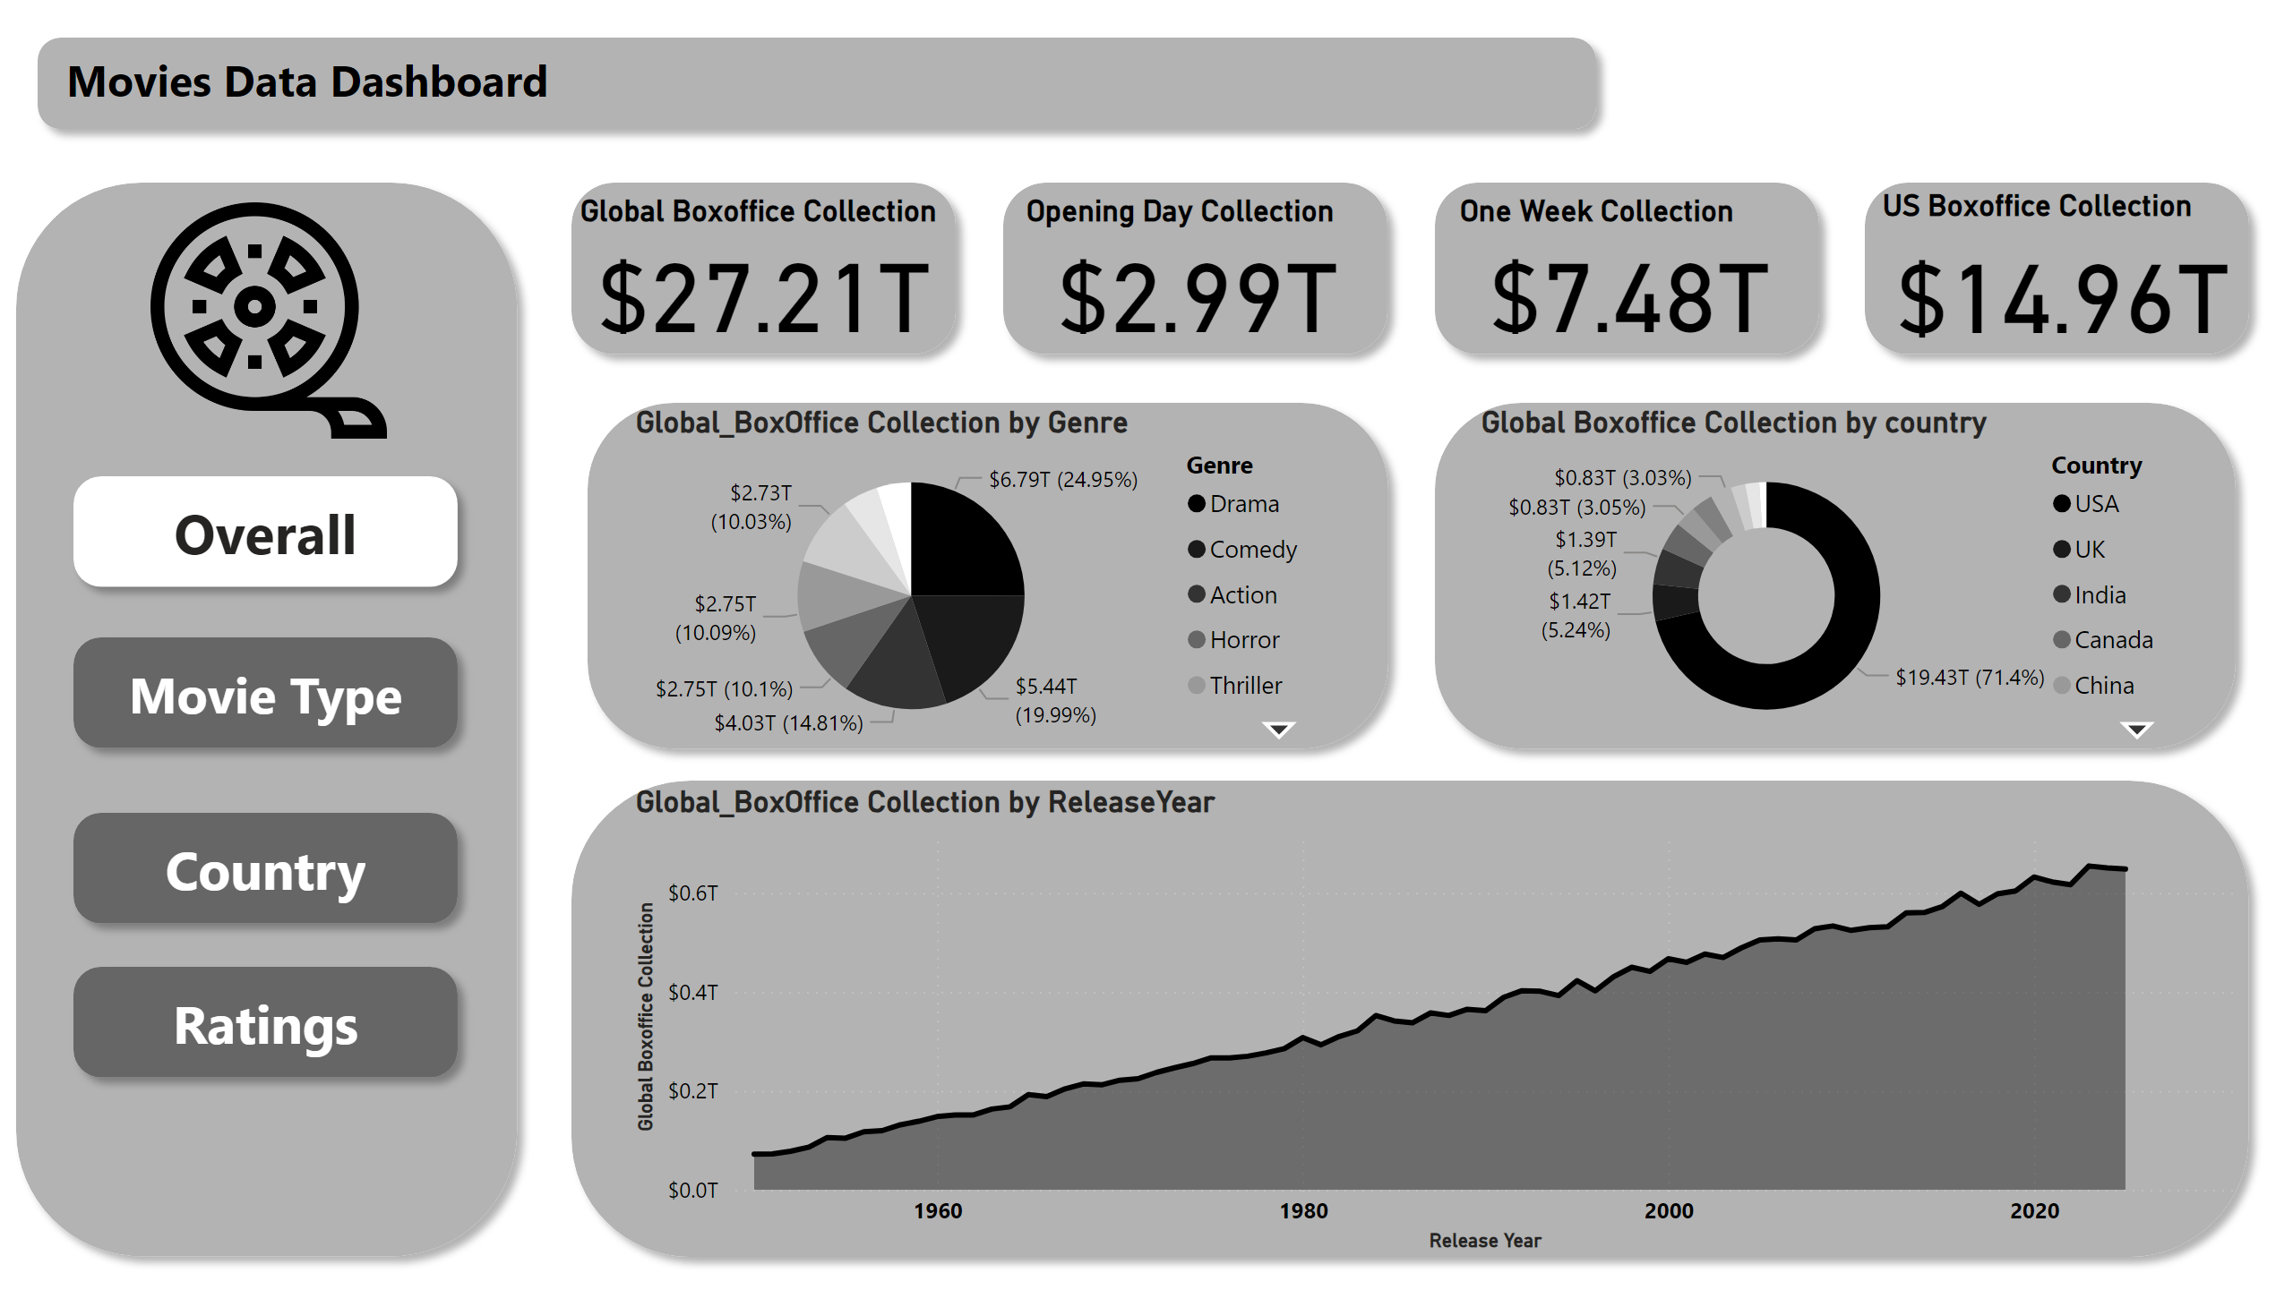
Overall
Notes:
shape
No alt text provided
shape
No alt text provided
shape
No alt text provided
shape
No alt text provided
shape
No alt text provided
shape
No alt text provided
shape
No alt text provided
shape
No alt text provided
shape
No alt text provided
shape
No alt text provided
shape
No alt text provided
shape
No alt text provided
textbox
No alt text provided
image
No alt text provided
Global Boxoffice Collection
No alt text provided
Opening Day Collection
No alt text provided
One Week Collection
No alt text provided
US Boxoffice Collection
No alt text provided
Global Boxoffice Collection by country
No alt text provided
Global_BoxOffice Collection by Genre
No alt text provided
Global_BoxOffice Collection by ReleaseYear
No alt text provided
shape
No alt text provided

Slide 3
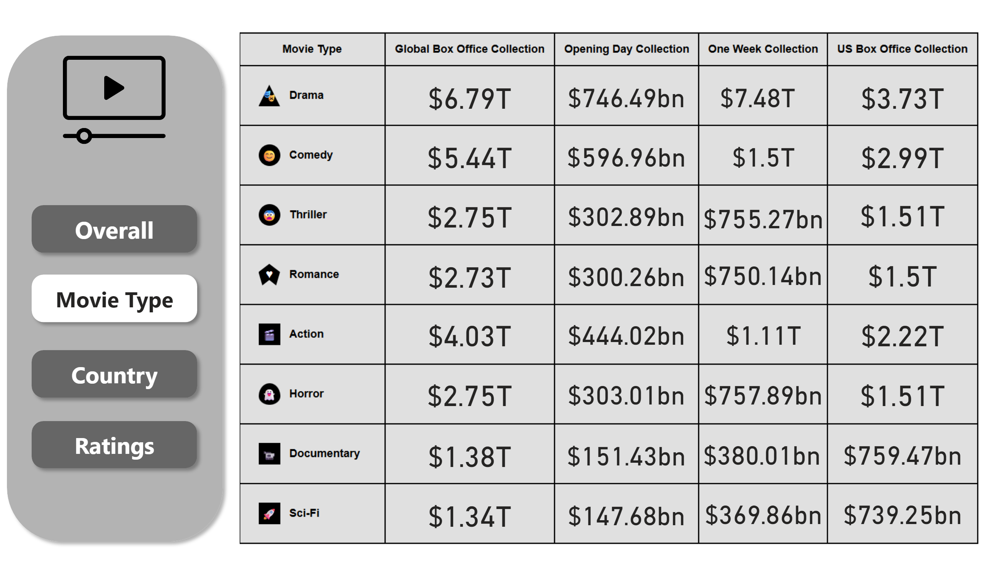
Movie Type
Notes:
shape
No alt text provided
shape
No alt text provided
shape
No alt text provided
shape
No alt text provided
image
No alt text provided
image
No alt text provided
card
No alt text provided
card
No alt text provided
card
No alt text provided
card
No alt text provided
card
No alt text provided
card
No alt text provided
card
No alt text provided
card
No alt text provided
card
No alt text provided
card
No alt text provided
card
No alt text provided
card
No alt text provided
card
No alt text provided
card
No alt text provided
card
No alt text provided
card
No alt text provided
card
No alt text provided
card
No alt text provided
card
No alt text provided
card
No alt text provided
card
No alt text provided
card
No alt text provided
card
No alt text provided
card
No alt text provided
card
No alt text provided
card
No alt text provided
card
No alt text provided
card
No alt text provided
card
No alt text provided
card
No alt text provided
card
No alt text provided
card
No alt text provided
shape
No alt text provided

Slide 4
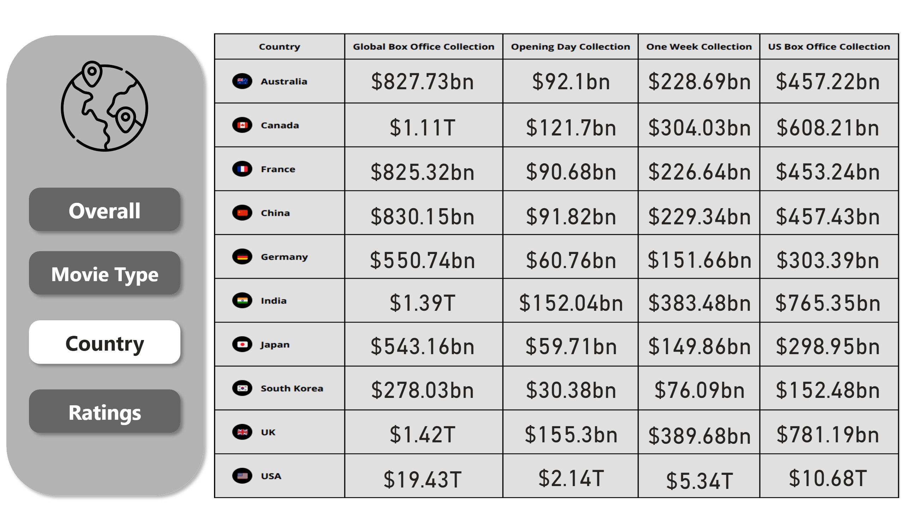
Country
Notes:
shape
No alt text provided
shape
No alt text provided
shape
No alt text provided
shape
No alt text provided
image
No alt text provided
image
No alt text provided
card
No alt text provided
card
No alt text provided
card
No alt text provided
card
No alt text provided
card
No alt text provided
card
No alt text provided
card
No alt text provided
card
No alt text provided
card
No alt text provided
card
No alt text provided
card
No alt text provided
card
No alt text provided
card
No alt text provided
card
No alt text provided
card
No alt text provided
card
No alt text provided
card
No alt text provided
card
No alt text provided
card
No alt text provided
card
No alt text provided
card
No alt text provided
card
No alt text provided
card
No alt text provided
card
No alt text provided
card
No alt text provided
card
No alt text provided
card
No alt text provided
card
No alt text provided
card
No alt text provided
card
No alt text provided
card
No alt text provided
card
No alt text provided
card
No alt text provided
card
No alt text provided
card
No alt text provided
card
No alt text provided
card
No alt text provided
card
No alt text provided
card
No alt text provided
card
No alt text provided
shape
No alt text provided

Slide 5
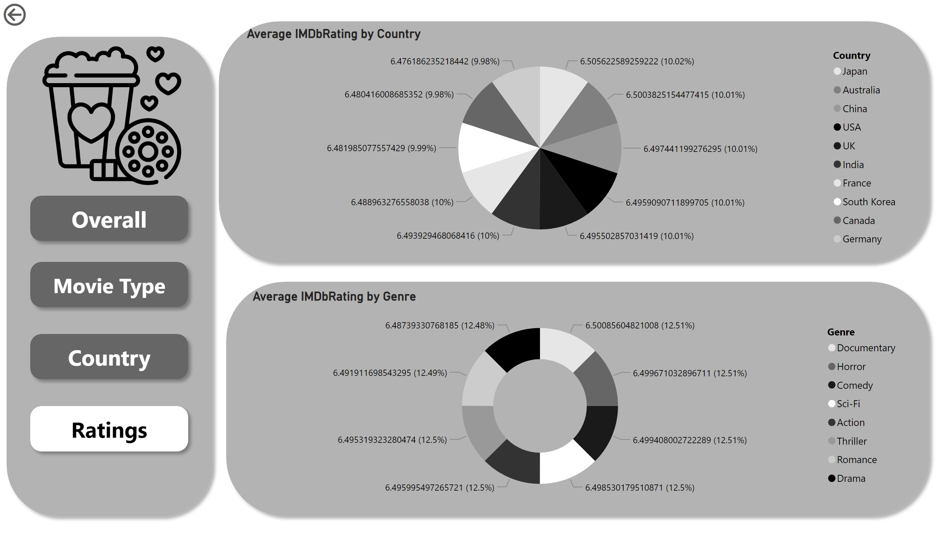
Ratings
Notes:
shape
No alt text provided
shape
No alt text provided
shape
No alt text provided
shape
No alt text provided
shape
No alt text provided
image
No alt text provided
actionButton
No alt text provided
shape
No alt text provided
Average IMDbRating by Country
No alt text provided
shape
No alt text provided
Average IMDbRating by Genre
No alt text provided

